Slide 1

SBI CREDIT CARD PROCESSING APPLICATION
N.B.K.R.I.S.T
VIDYANAGAR
AUTONOMUS
SBI CREDIT CARD PROCESSING APPLICATION SYSTEM using QUEUE IN C
PRESENTED BY
UNDER GUIDENCE
PRASANTH SIR
SURESH GUPTHA SIR
V.BHANUPRAKESHREDDY (24KB1A30C5)​
CH.MAHESH (24KB1A3017)​
J.SAI KRISHNA (24KB1A3035)​
G.SRI HARI (24KB1A3029)​
​

Slide 2
OBJECTIVE
This project simulates a real-world credit card application processing system using data structures. It uses a queue-based approach to handle multiple applications in the order they are received. Linked list concepts are applied for dynamic memory allocation and flexibility in managing the queue. Users can apply, view, and process credit card applications efficiently through a command-line menu interface. The system helps reinforce understanding of queue operations like enqueue, dequeue, and peek using C programming.

Slide 3
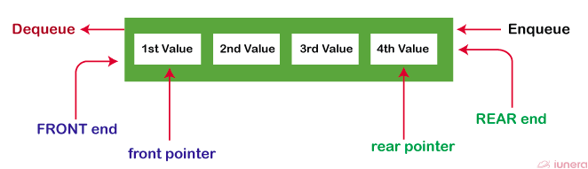
A Queue Data Structure is a fundamental concept in computer science used for storing and managing data in a specific order.
QUEUE
A Queue Data Structure is a fundamental concept in computer science used for storing and managing data in a specific order.
It follows the principle of "First in, First out" (FIFO), where the first element added to the queue is the first one to be removed.

Slide 4
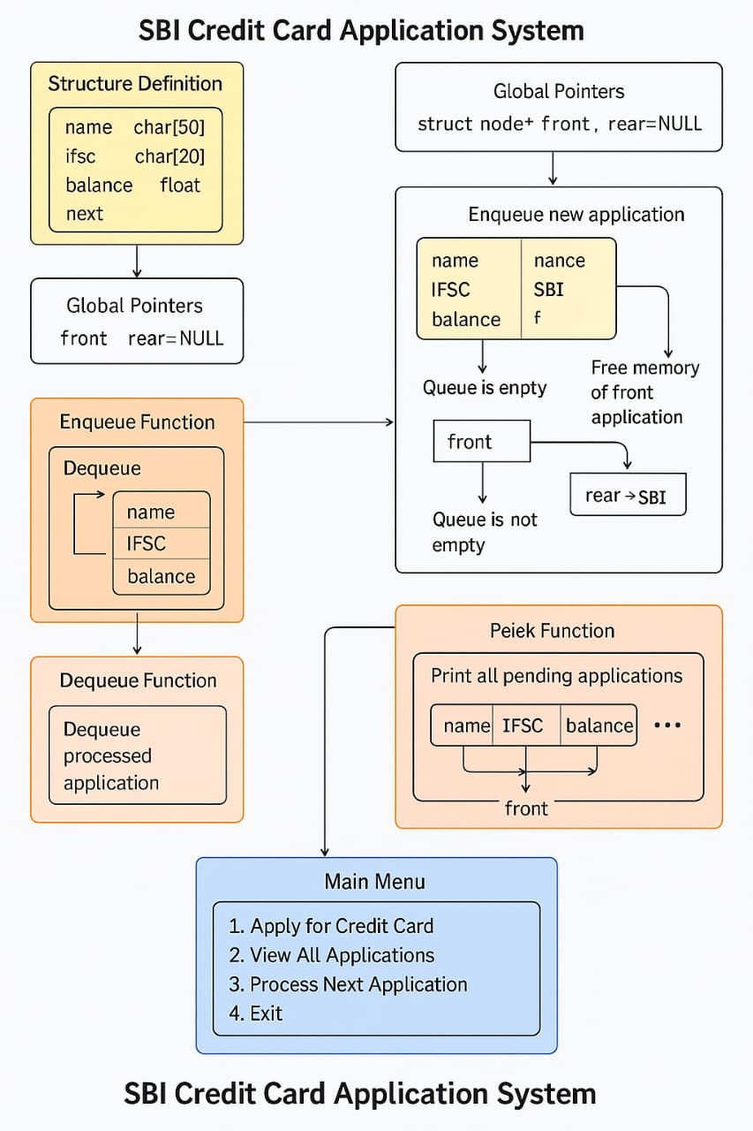
Diagramatic view of the application

Slide 5
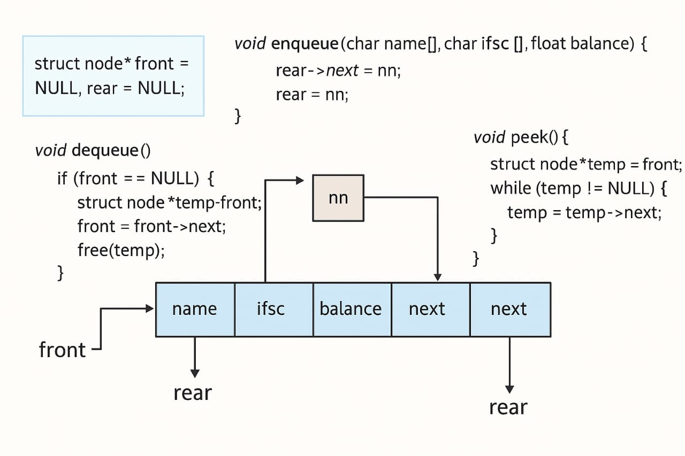

Slide 6
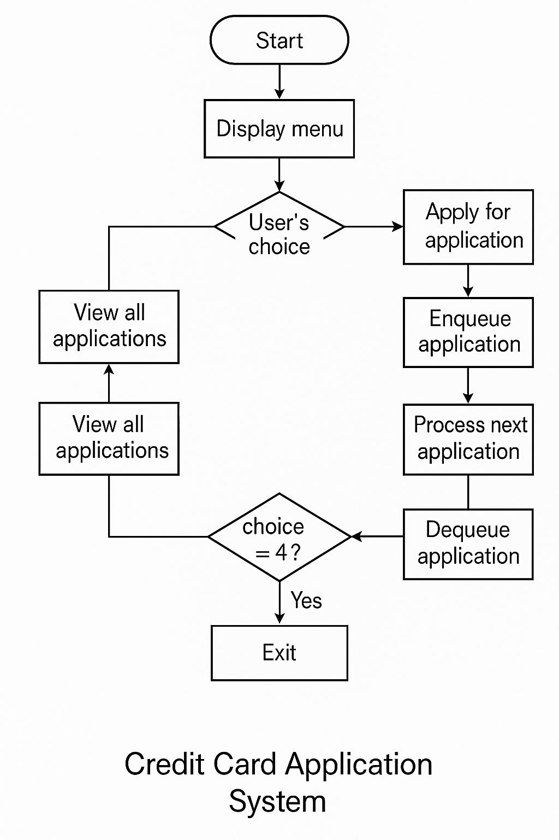
FLOW CHART

Slide 7
SOURCE LINK
https://github.com/maheshchallagiri/SBI-banking-application-process-/blob/main/main.c#L1

Slide 8
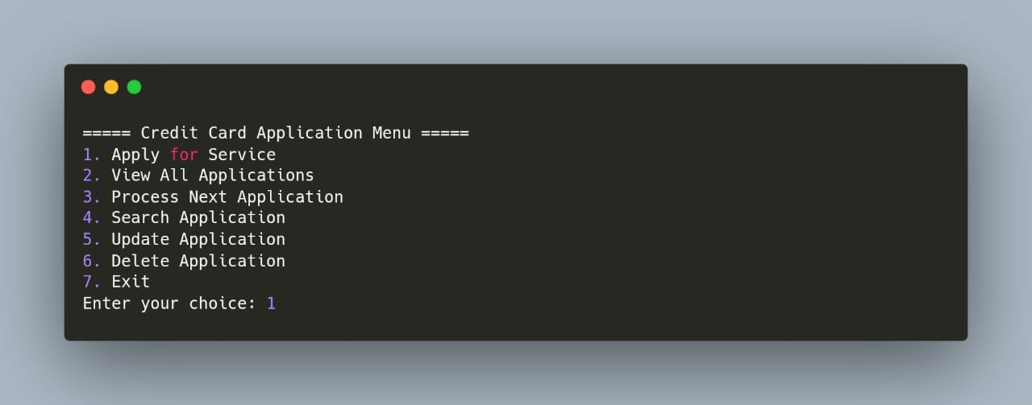
Sample output

Slide 9
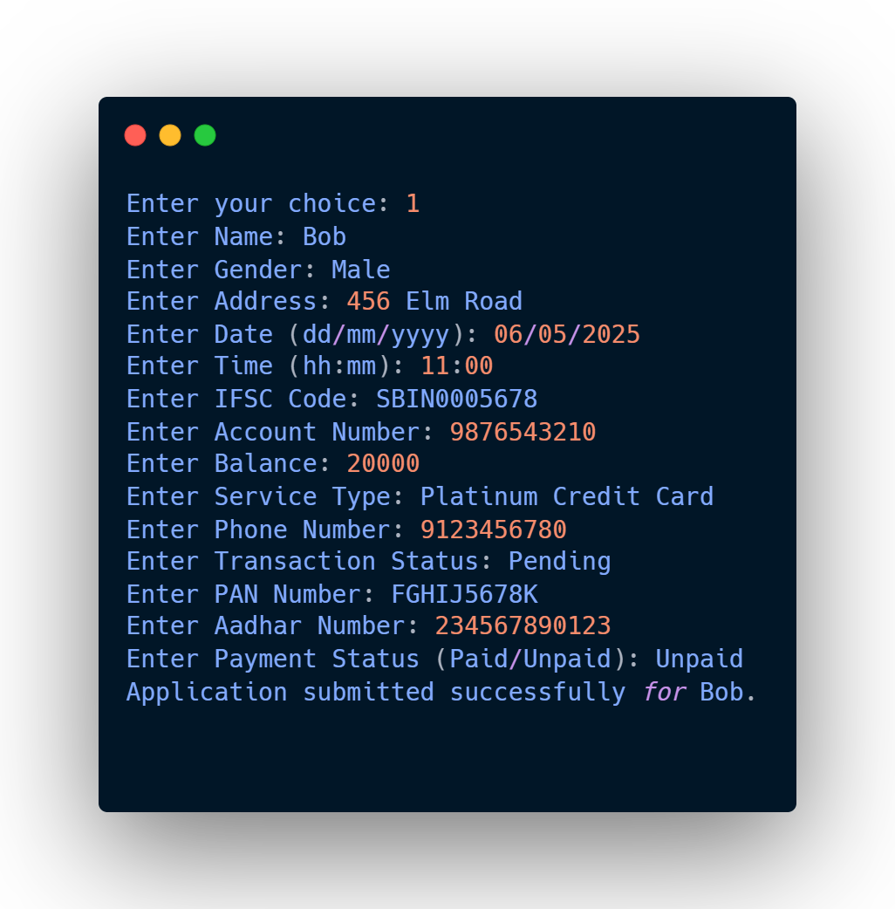
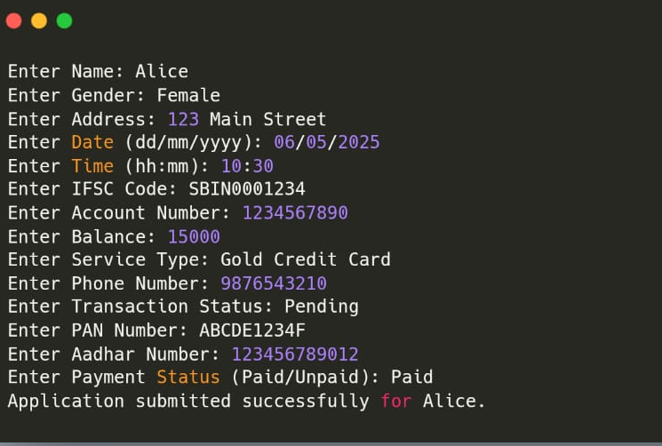
User adds another application:
(User applies for a service)

Slide 10
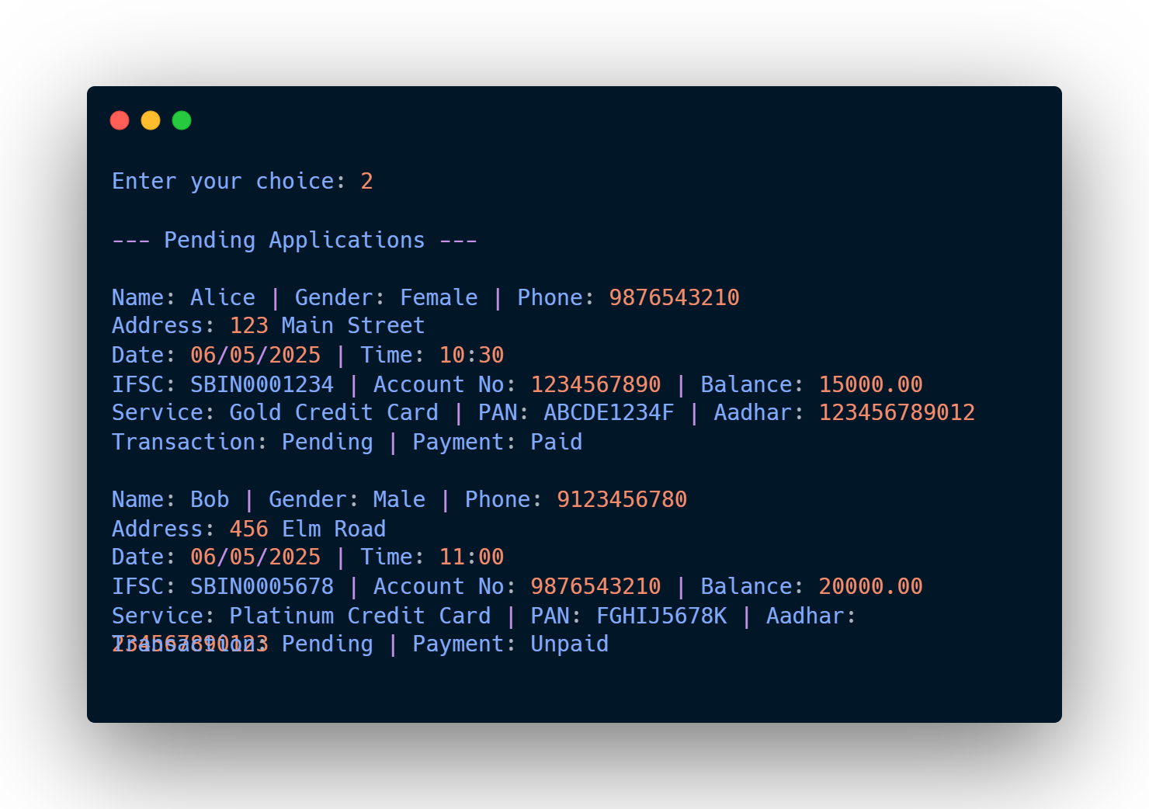
User views all applications:

Slide 11
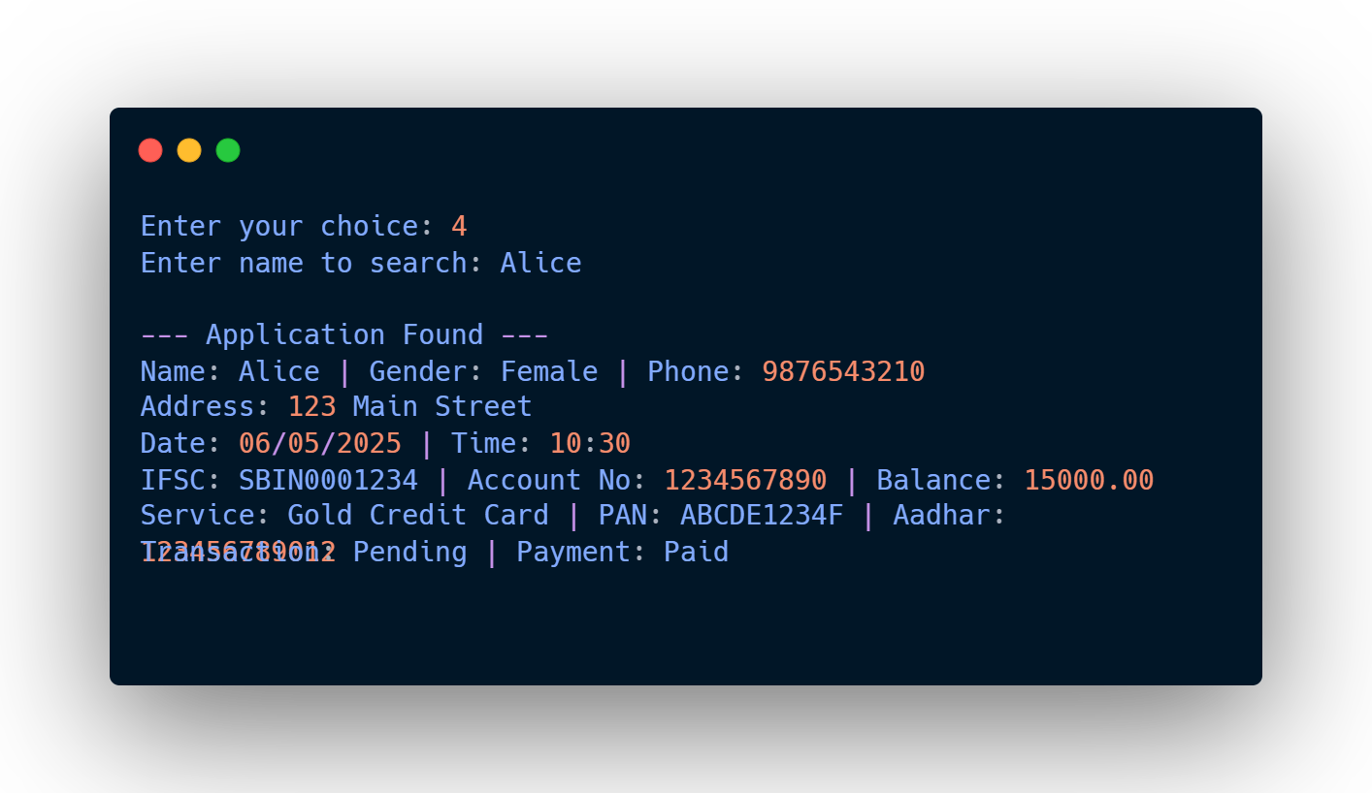
User searches for Alice:

Slide 12
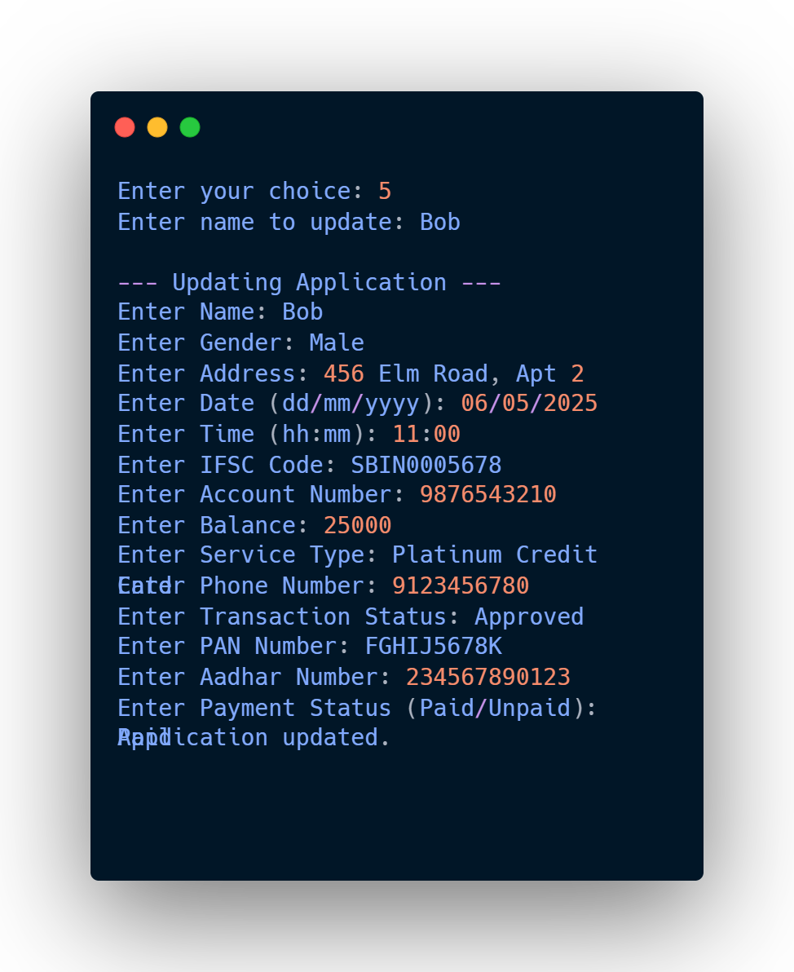
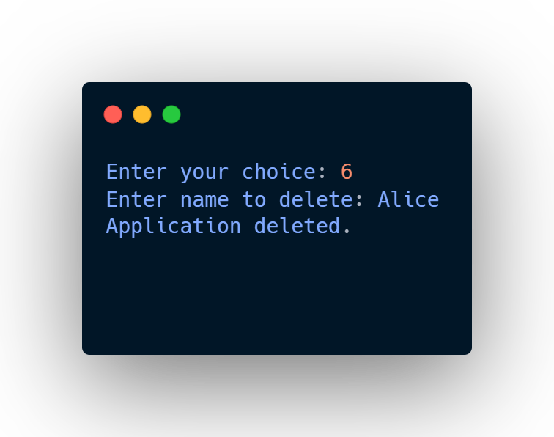
User updates Bob’s application:
User deletes Alice’s application:

Slide 13
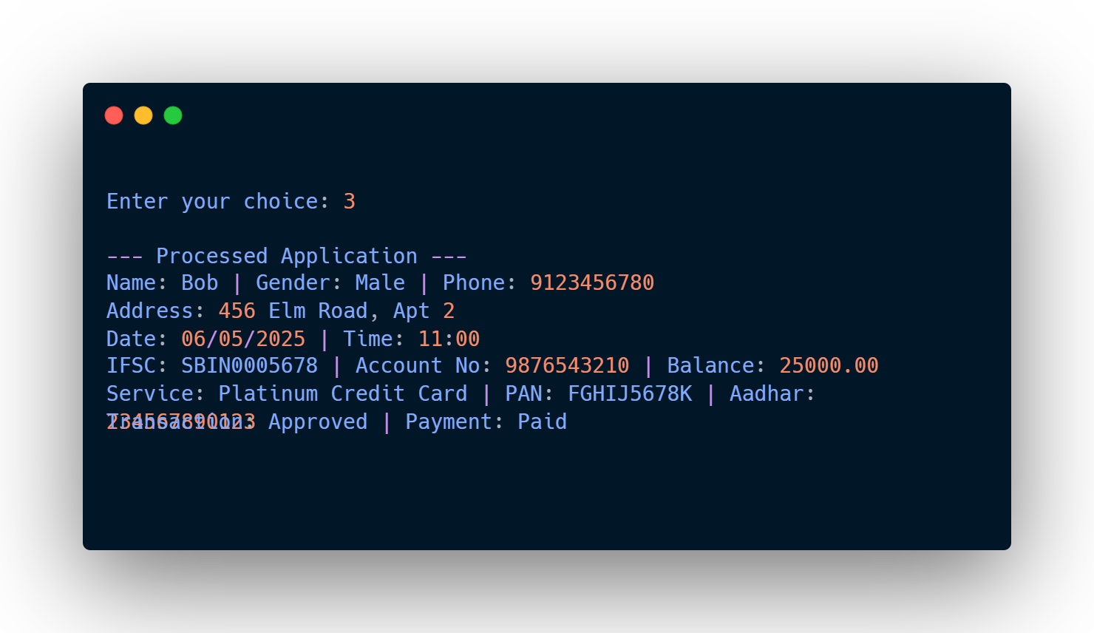
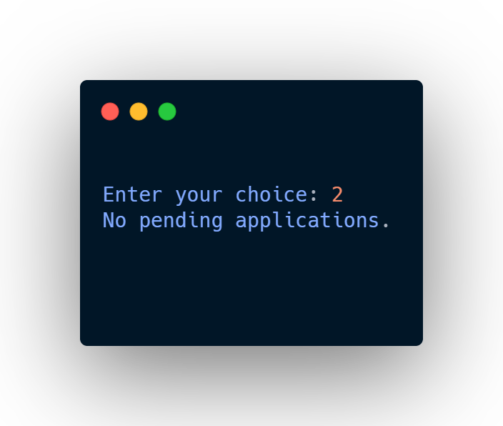
User processes the next application (Bob):
User tries to view applications again:

Slide 14
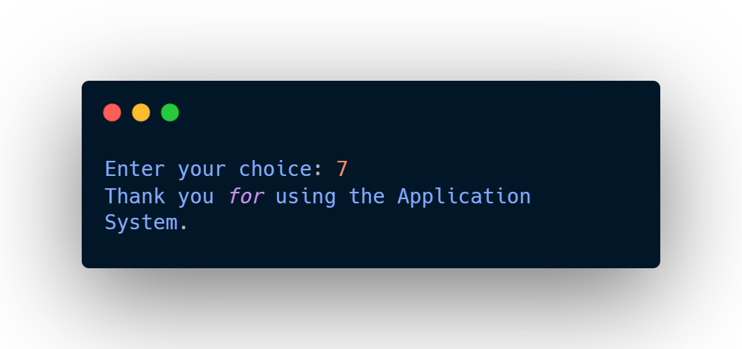
User exits the program:

Slide 15
✅ Conclusion
In this project, we created a simple system to manage credit card applications using the concept of queues in C language.
Users can apply for a card, view their application, search by name, update or delete it, and process applications one by one in the order they came.
We used a linked list to make the queue work well even when applications are added or removed.
This project helped us understand how data structures like queues work in real programs. We also practiced functions, pointers, and user input in C.

Slide 16

THANK YOU

